Slide 1
HR Data Analysis
•Excel •Power BI •Tableau •SQL
Prepared By: Mahesh Khandgave
Domain: HR Analytics

Slide 2
Project Introduction
HR Analytics helps understand workforce patterns
Focus on attrition, salary, performance & satisfaction
Multi-tool approach improves accuracy
Visual dashboards from 3 tools + SQL insights

Slide 3
Objectives of the Project
Identify key factors causing attrition
Analyze salary vs job roles
Study work-life balance impact
Determine high-risk departments
Generate data-driven HR recommendations

Slide 4
Tools Used
Excel
KPI Dashboard
Pivot Tables
Tableau
Advanced visual analytics
Interactive filters
Power BI
Dynamic dashboards
DAX measures
SQL
Employee count
Attrition metrics

Slide 5
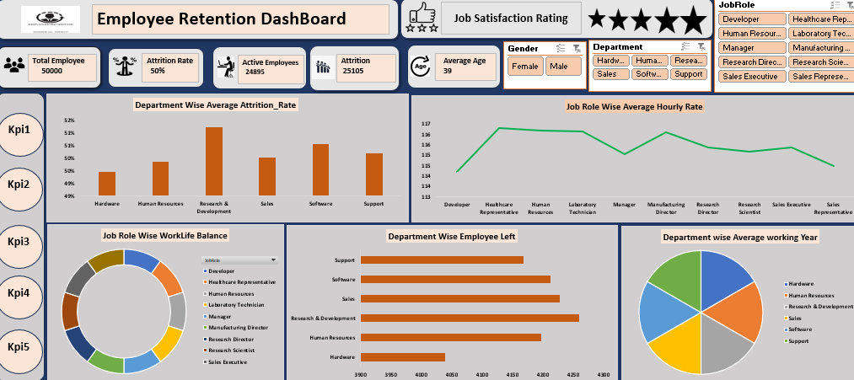
Excel Dashboard Insights
Total employees
Attrition count & percentage
Age segmentation
Gender ratio
Department distribution
Salary categories

Slide 6
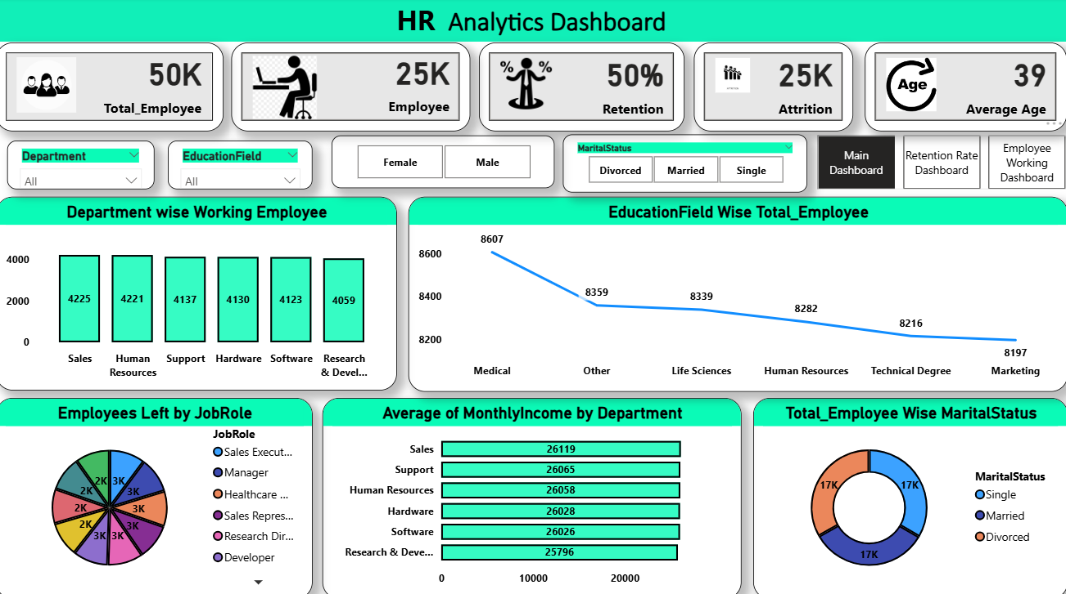
Power BI Dashboard Insights
Attrition by job role
Overtime vs attrition
Salary distribution
Department KPIs

Slide 7
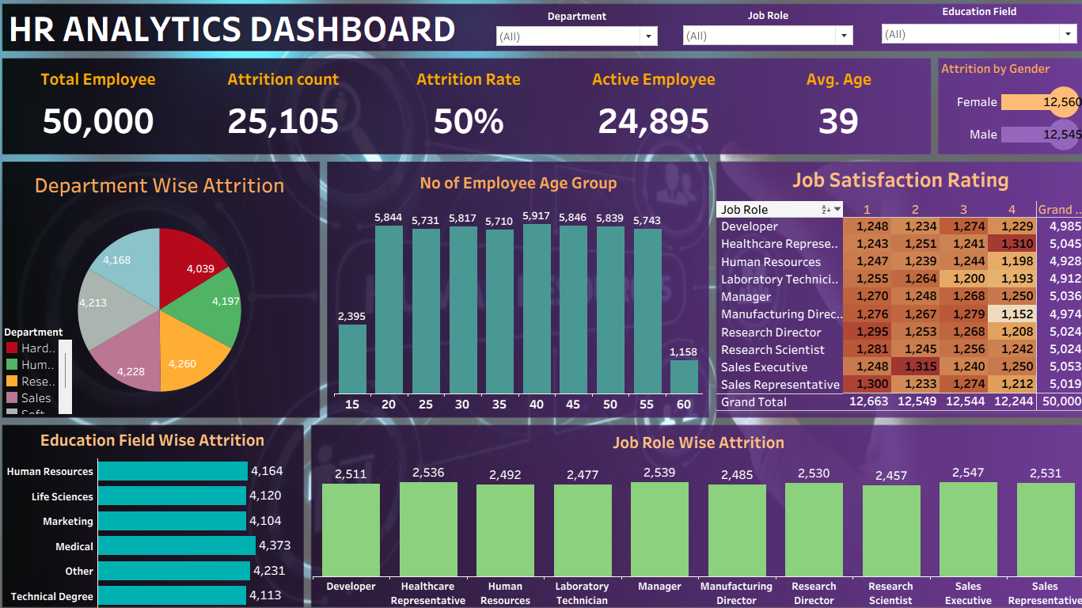
Tableau Dashboard Insights
Attrition by department
Salary vs age
Work-life balance
Custom filters
(Age, Gender, Department)

Slide 8
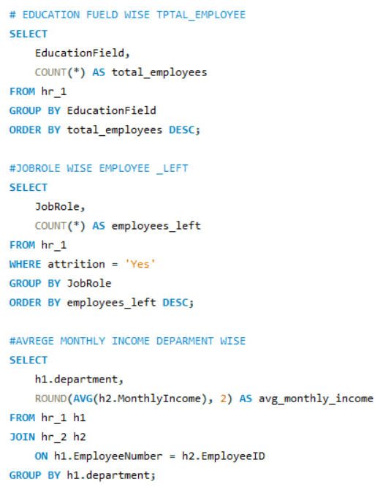
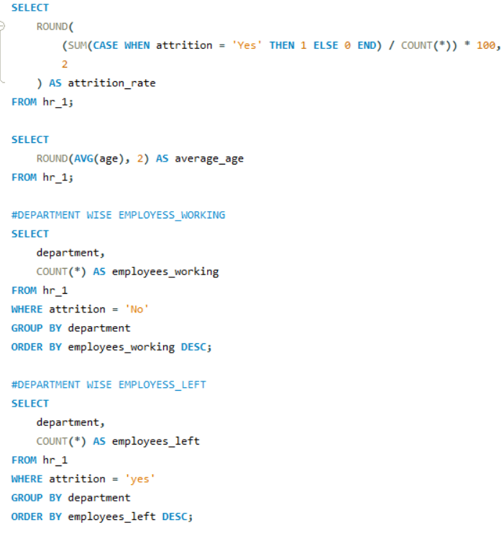
SQL Queary

Slide 9
Key Insights
Overtime employees leave more
Highest attrition age group: 25–35
Sales & R&D departments most affected
Low salary group faces higher stress
Work-life balance directly impacts retention

Slide 10
Conclusion & Recommendation
Conclusion
HR data shows clear patterns affecting retention
Dashboards help identify risk groups
Data supports HR decision-making
Recommendations
Reduce overtime pressure
Improve salary for low-income roles
Offer training & growth opportunities
Run employee satisfaction programs

